Slide 1

Regular Expressions

Slide 2
Contents
Regular Experesion
Text Normalization
SDIT Distance

Slide 3
Regular Experession
Definition of Regular Expressions (regex)
Regular Expressions, often abbreviated as regex, are sequences of characters that serve as powerful tools for defining search patterns within text data.
These patterns allow for sophisticated text matching, manipulation, and validation.

Slide 4
Regular Experession
Functionality of Regular Expressions
Regular expressions are extensively used for various text-related tasks:
Searching: Regex enables the identification of specific patterns within text, allowing for efficient data extraction and analysis.
Manipulating: Regex can modify or rearrange text by replacing or transforming substrings based on specified patterns.
Validating: Regular expressions assist in verifying whether text adheres to a predefined pattern or format, such as checking if an email address is correctly structured.

Slide 5
Regular Experession
Example
Let's consider the task of finding email addresses within a text document using a basic regex pattern:
[a-zA-Z0-9._%+-]+ matches the username part of the email.
@ matches the literal "@" character.
[a-zA-Z0-9.-]+ matches the domain name (e.g., gmail.com).
\.[a-zA-Z]{2,} matches the top-level domain (e.g., .com) using the period (.) as an escaped character.

Slide 6
Regular Experession
Syntax
Regular expressions use a combination of normal characters and special metacharacters to define patterns.
^ (Caret): This metacharacter denotes the start of a line or string. It's used to anchor patterns at the beginning.
Example: ^Hello matches lines or strings that start with "Hello".
$ (Dollar Sign): The dollar sign indicates the end of a line or string. It's used to anchor patterns at the end.
Example: world$ matches lines or strings that end with "world".
. (Period/Dot): The dot matches any single character except a newline. It's a wildcard that can be used to represent any character.
Example: col.r matches "color", "colour", "collar", etc.

Slide 7
Regular Experession
Syntax
* (Asterisk): The asterisk matches the preceding character or group zero or more times.
Example: ab*c matches "ac", "abc", "abbc", "abbbc", and so on.
+ (Plus): The plus matches the preceding character or group one or more times.
Example: go+l matches "gol", "gool", "gooool", and so on.
? (Question Mark): The question mark matches the preceding character or group zero or one time.
Example: colou?r matches "color" and "colour".

Slide 8
Regular Experession
Quantifiers
Quantifiers in regular expressions define how many times a preceding character or group should occur. They allow for specifying the frequency of occurrences in a flexible manner.
* (Asterisk): This quantifier matches zero or more occurrences of the preceding character or group.
Example: go*l matches "gl", "gol", "gool", "gooool", and so on.
+ (Plus): The plus quantifier matches one or more occurrences of the preceding character or group.
Example: go+l matches "gol", "gool", "gooool", and so on.

Slide 9
Regular Experession
Quantifiers
? (Question Mark): The question mark quantifier matches zero or one occurrence of the preceding character or group.
Example: colou?r matches "color" and "colour".
{m}: Curly braces with a specific number (m) indicate exactly m occurrences of the preceding character or group.
Example: x{3} matches "xxx".
{m,n}: Curly braces with a range (m and n) specify a minimum of m occurrences and a maximum of n occurrences of the preceding character or group.
Example: o{2,4} matches "oo", "ooo", and "oooo".

Slide 10
Regular Experession
Groups and Capturing
Groups in regular expressions, created using parentheses (), serve two main purposes:
Capturing: Groups allow you to capture and extract portions of the matched text for further use.
Grouping: Groups help to define the scope of quantifiers and alternations.
Non-Capturing Groups
Non-capturing groups (?: ) are used when you need to group parts of a pattern but don't want to capture the matched text. They don't store the captured value for retrieval.

Slide 11
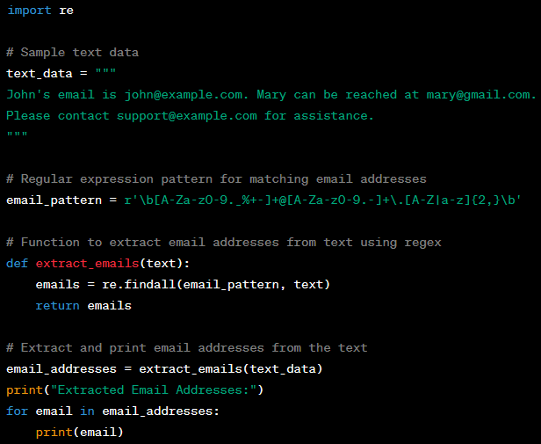
Example in Python
In this example, the regular expression
r'\b[A-Za-z0-9._%+-]+@[A-Za-z0-9.-]+\.[A-Z|a-z]{2,}\b’
is used to match valid email addresses.
The re.findall() function is used to find all occurrences of the pattern in the text and return them as a list.

Slide 12
Practice
Regular Expersions Practice
  Instructions
    Create a Python program that performs text pattern matching using regular expressions. You'll work with a dataset containing various types of information.
    Your task is to extract specific patterns from the text using regular expressions.
  Dataset
    text_data = """John's email is john@example.com. Mary can be reached at mary@gmail.com.
    The meeting is scheduled for 2023-09-15. Don't forget to bring your ID!
    Our support hotline is (123)456-7890. Call us if you have any questions. ""“
  Tasks
    Task 1 - Extract Emails: Write a function extract_emails(text) that takes a text as input and returns a list of all email addresses present in the text.
    Task 2 - Extract Dates Write a function extract_dates(text) that takes a text as input and returns a list of all dates in the format "YYYY-MM-DD" present in the text.
    Task 3 - Extract Phone Numbers Write a function extract_phone_numbers(text) that takes a text as input and returns a list of all phone numbers in the format "(123)456-7890" present in the text.

Slide 13
Text Normalization
Techniques
Case Normalization
Case normalization involves converting text to a consistent case, usually lowercase or uppercase. This ensures uniformity in text analysis regardless of the original case.
Example:
Original: "Hello World"
Case Normalized (Lowercase): "hello world"
Case Normalized (Uppercase): "HELLO WORLD"

Slide 14
Text Normalization
Techniques
Punctuation and Special Character Removal
Removing punctuation and special characters from text helps eliminate noise that might interfere with analysis. This is especially useful for tasks like sentiment analysis or keyword extraction.
Example:
Original: "Wow! What an amazing day!!! :)"
After Removal: "Wow What an amazing day"

Slide 15

Text Normalization
Techniques
Whitespace and Line Break Handling
Handling whitespace and line breaks ensures consistent spacing and structure. Extra whitespace and line breaks can cause inconsistency in text data.
Example:
Original:
After Handling: "The quick brown fox jumps over the lazy dog."

Slide 16
Text Normalization
Stemming and Lemmatization
Stemming: Stemming involves removing prefixes, suffixes, and inflections from words to obtain their root form. The resulting stems might not always be actual words.
Lemmatization: Lemmatization, on the other hand, involves transforming words to their dictionary or base form (lemma), which is a valid word. Lemmatization considers word context and part-of-speech information for accuracy.

Slide 17
Text Normalization
Stemming and Lemmatization
Example:
Sentence: "Running shoes are better for runners."
Stemming (Porter Stemmer):
"run": running, runners
"shoe": shoes
"better": better
Lemmatization:
"run": running, runners
"shoe": shoes
"be": better

Slide 18
Text Normalization
Stop Word Removal
Stop words are common words that are frequently used in a language but generally do not carry significant meaning on their own. These words are often removed from text data during preprocessing to improve the quality of text analysis and reduce computational load.
Examples
Articles: "a", "an", "the"
Prepositions: "in", "on", "under", "with"
Pronouns: "I", "you", "he", "she", "it"
Conjunctions: "and", "but", "or"
Common verbs: "is", "are", "am", "was", "were"

Slide 19
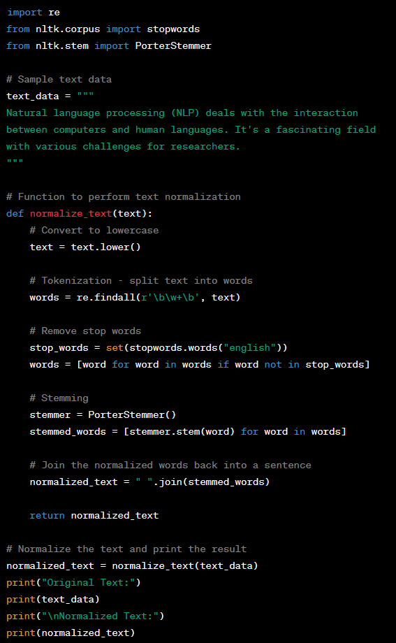
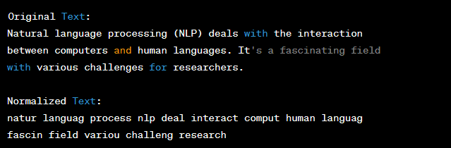
Example in Python
In this example, the normalize_text function performs the following normalization steps
Converts the text to lowercase.
Tokenizes the text by splitting it into words.
Removes common stop words using the NLTK library.
Applies stemming to reduce words to their base form using the Porter stemming algorithm.
Joins the normalized words back into a sentence.

Slide 20
Practice
Text Normalization Practice
  Instructions
    Create a Python program that performs text normalization using lowercasing, stemming, and stop word removal.
    You'll work with a dataset containing sample text. Your task is to normalize the text by applying these techniques.
  Dataset
    text_data = """
    Natural language processing (NLP) involves the application of
    linguistic analysis to comprehend and generate human language.
    It's an exciting field with diverse challenges and applications.
    """
    # List of sample stop words
    stop_words = ["the", "and", "of", "it's", "with", "an", "to", "is", "and"]

Slide 21
Practice
Text Normalization Practice
  Task 1: Lowercasing
    Write a function lowercase_text(text) that takes a text as input and returns the same text with all characters converted to lowercase.
  Task 2: Tokenization and Stop Word Removal
    Write a function remove_stop_words(text, stop_words) that takes a text and a list of stop words as input and returns the text with the specified stop words removed.
  Task 3: Stemming
    Write a function stem_text(text) that takes a text as input and returns the text with words stemmed using the Porter stemmer algorithm.
  Task 4: Complete Normalization
    Write a function normalize_text(text, stop_words) that takes a text and a list of stop words as input and returns the normalized text by applying lowercasing, tokenization, stop word removal, and stemming.

Slide 22
SDIT Distance
Introduction
SDIT Distance is a string similarity metric that measures the similarity between two strings by considering the minimum number of insertions and transpositions required to transform one string into the other.
It's particularly useful when transpositions (swapping adjacent characters) are common in the transformation process.

Slide 23
SDIT Distance
Applications in NLP
Spelling correction: Identifying and suggesting corrections for transposed or mistyped characters in text.
Plagiarism detection: Identifying text segments that have been reorganized or slightly modified.
Detecting fraudulent transactions involving textual information, where attackers might subtly modify text to avoid detection.

Slide 24
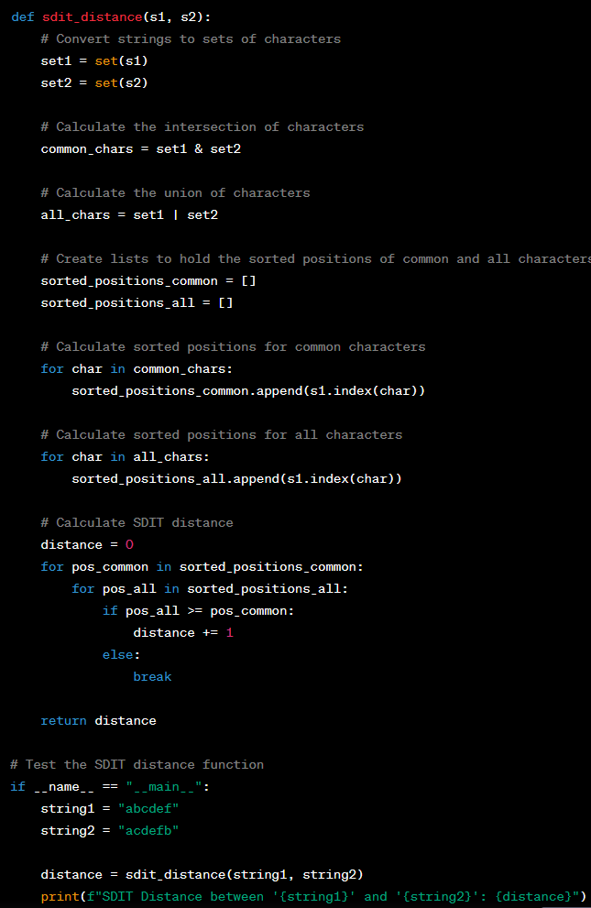
Example in Python
Calculating the Sorted-Distance-Insensitive-Tolerant (SDIT) distance between two strings
In this example, the sdit_distance function calculates the SDIT distance between two strings by considering the positions of characters in both strings.
The SDIT distance is the count of pairs of characters where the character from the first string comes before or at the same position as the character from the second string.
The example compares the strings "abcdef" and "acdefb" and calculates their SDIT distance.

Slide 25
Q & A

